Slide 1
Animal Bites
If you were to get bitten by an animal, what animal, type of species, and when during the year is the most likely scenario to get bitten?

Slide 2
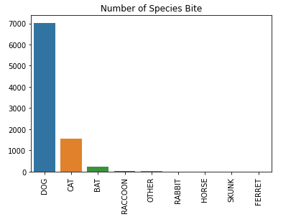
Species Bites
Out of all the animals collected from the data the highest chance bitten animal would be a Dog, with about 7000 cases.
The second and third are Cat and Bat with 1500 and 200, respectively.

Slide 3
Which month in the year is which animal most likely going to bite in?

Slide 4
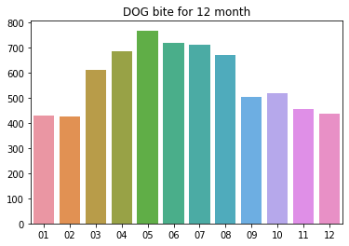
Dogs

Slide 5
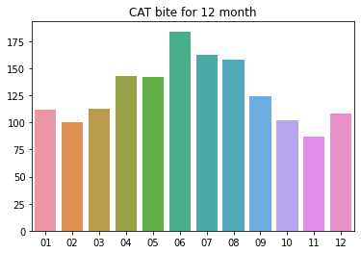
Cats

Slide 6
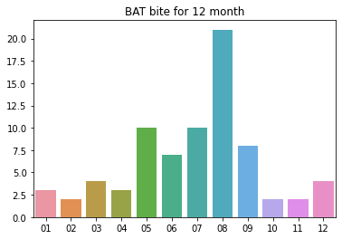
Bats

Slide 7
Seems like the summer month (5-8) is the most likely scenario
This is most likely due to people are out more with their animals walking and have more free time than the other months.

Slide 8
Dogs seem like the most likely scenario, however which species of dog bits the most?

Slide 9
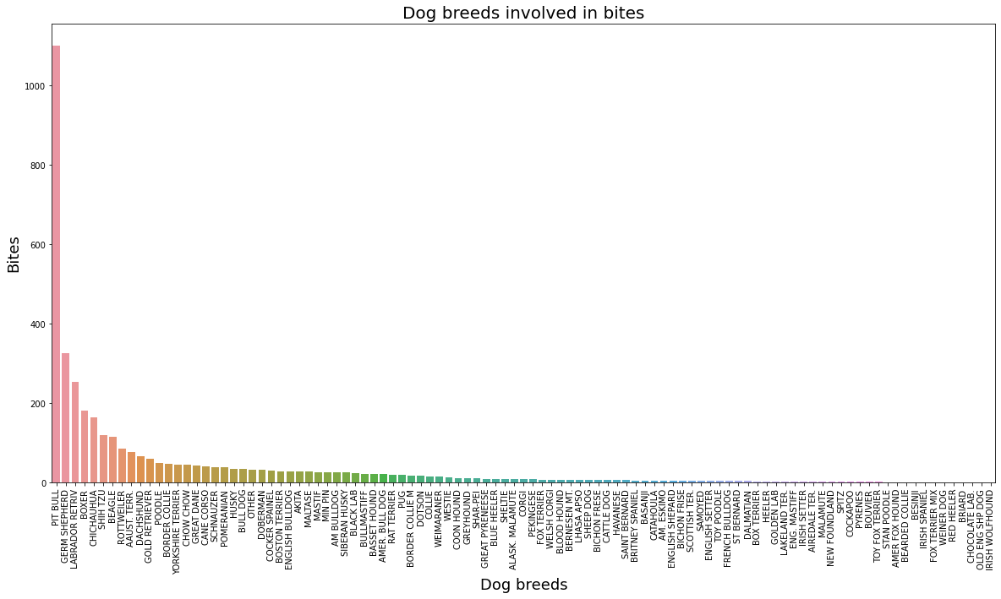

Slide 10
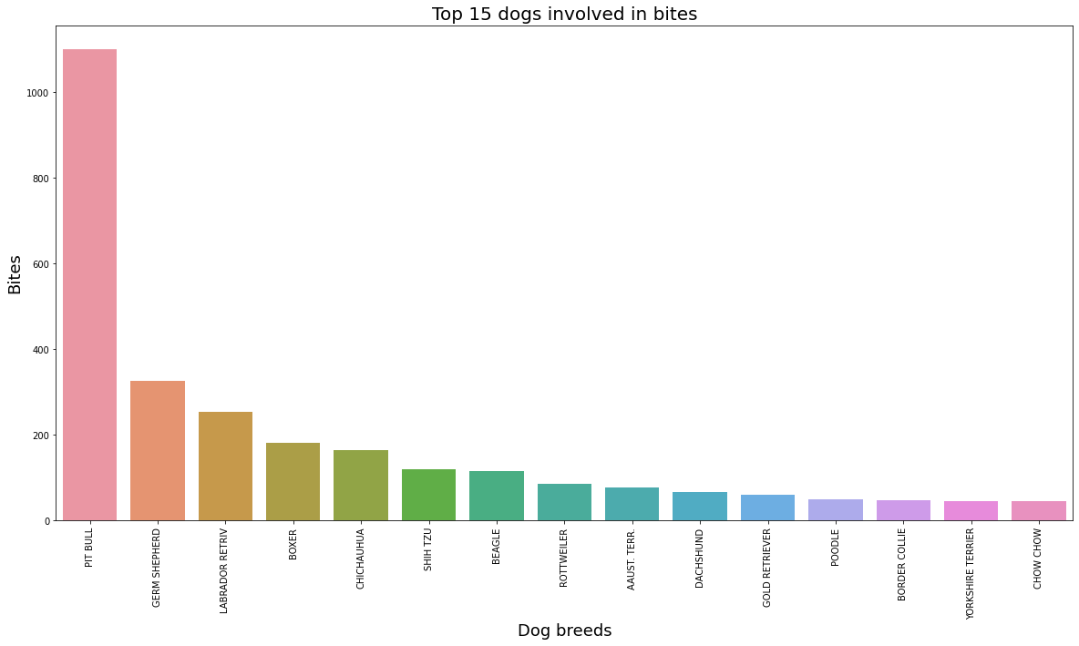
Filtering the graph to take the top 15 most dog species
We see that Pit Bulls have the highest chance of biting than the rest

Slide 11
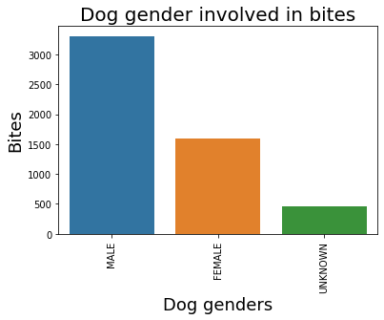
Male or Female more common?
Male dogs have a higher chance of biting by almost twice the chance of a female

Slide 12
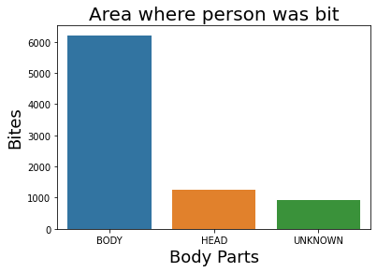
More likely to be bit on the body or the head?
Body is significantly a higher chance of getting attacked

Slide 13
If one had to guess what kind of attacked, the highest chance would be a Male Pitbull dog attacking the body in the summer

